Slide 1

ARTIFICIAL INTELLIGENCE(SE321)
DELHI TECHNOLOGICAL UNIVERSITY(DTU)
PROJECT ON RADIAL BASIS FUNCTION NETWORK
Submitted by:
Ashish Kumar - (2K18/SE/041) Kevin Tirkey - (2K18/SE/074)
Submitted to :
Dr. Aruna Bhat

Slide 2
PROBLEM STATEMENT
Radial basis function (RBF) networks are a commonly used type of artificial neural network for function approximation problems. Radial basis function networks are distinguished from other neural networks due to their universal approximation and faster learning speed.
RBF networks have fixed three-layer architecture which consists of input layer, hidden layer and output layer. Because of the similar layer-by-layer topology, it is often considered that RBF networks belong to the traditional neural networks such as the MLP(multilayer perceptron) networks but in reality both behave very differently.
RBF networks are simpler than MLP networks which may have more than three layers architectures, so the training process is generally faster than that of MLP networks.
RBF networks act as local approximation networks, because the network outputs are determined by specified hidden units in certain local receptive fields; while MLP networks work globally, since the network outputs are decides by all the neurons.
MLP network models are highly vulnerable to adversarial noise and can make very wrong predictions when fed with such examples as their inputs. This is not the case in RBF networks which is due to the non-linear nature of these networks.
Practically, MLP networks are very inefficient for solving problems so RBF networks are used because it is good for novelty detection as RBF neurons have maximum activation when the center/weights are equal to the inputs and also RBF networks bring much more robustness to the prediction.

Slide 3
ABSTRACT
This presentation is a detailed introduction to radial basis function(RBF) networks, a type of artificial intelligence network for application to problem of supervised learning(eg. regression, classification and time series prediction).
Many aspects associated with the RBF network, such as network structure or architecture, radial basis functions, some algorithms are described here.

Slide 4
INTRODUCTION
Radial Basis Function(RBF) network was formulated by Broomhead and Lowe in 1988. Since Radial basis functions (RBFs) have only one hidden layer, the convergence of optimization objective is much faster, and despite having one hidden layer RBFs are proven to be universal approximators.
RBF networks have many applications like function approximation, interpolation, classification and time series prediction. All these applications serve various industrial interests like stock price prediction, anomaly detection in data, fraud detection in financial transaction etc.
This presentation provides a detailed introduction to Radial Basis Function Networks along with its structure, mathematical and algorithmic introduction. In the last section, conclusion is presented.

Slide 5
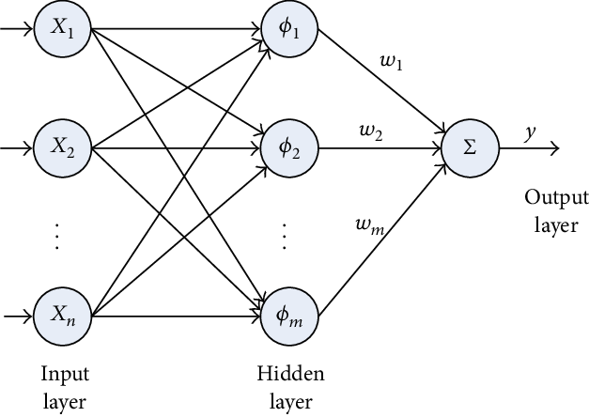
OVERVIEW OF RBF NETWORKS
A Radial Basis Function Network, or RBF for short, is a form of neural network that relies on the integration of the Radial Basis Function and is specialized for tasks involving non-linear classification.
Radial basis function networks are distinguished from other neural networks due to their universal approximation and faster learning speed.
An RBF network is a type of feed forward neural network composed of three layers, namely the input layer, the hidden layer and the output layer.

Slide 6
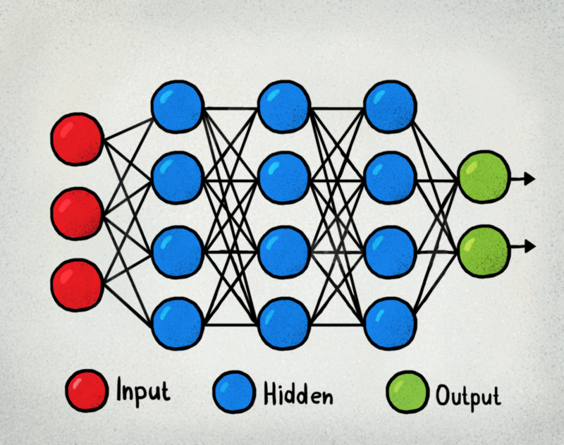
One neuron in the input layer corresponds to each predictor variable. The input neurons feed the values to each of the neurons in the hidden layer.
Hidden layer has a variable number of neurons. Each neuron consists of a radial basis function(eg. Gaussian) centered on a point with as many dimensions as there are predictor variables.
The value coming out of a neuron in the hidden layer is multiplied by a weight associated with the neuron and passed to the summation which adds up the weighted values and presents this sum as the output of the network.

Slide 7
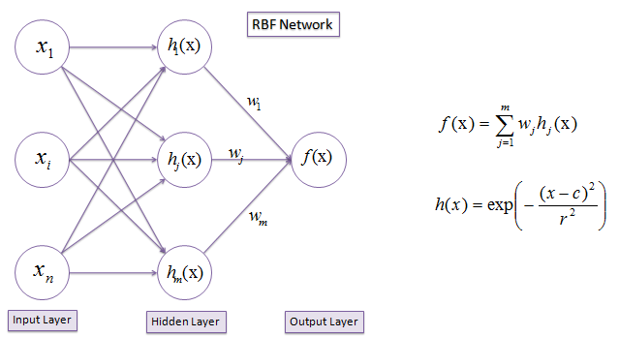
STRUCTURE OF RBF NETWORKS

Slide 8
ALGORITHM
h(x) is the Gaussian activation function with the parameters r (the radius or standard deviation) and c (the center or average taken from the input space) defined separately at each RBF unit.
The learning process is based on adjusting the parameters of the network to reproduce a set of input-output patterns.
There are three types of parameters; the weight w between the hidden nodes and the output nodes, the center c of each neuron of the hidden layer and the unit width r.
Unit Center (c)
Any clustering algorithm can be used to determine the RBF unit centers (e.g., K-means clustering). A set of clusters each with r-dimensional centers is determined by the number of input variables or nodes of the input layer. The cluster centers become the centers of the RBF units. The number of clusters, H, is a design parameter and determines the number of nodes in the hidden layer.
The K-means clustering algorithm proceeds as follows:
1. Initialize the center of each cluster to a different randomly selected training pattern.
2. Assign each training pattern to the nearest cluster. This can be accomplished by calculating the euclidean distances between the training patterns and the cluster centers.
3. When all training patterns are assigned, calculate the average position for each cluster center. They then become new cluster centers.
4. Repeat steps 2 and 3, until the cluster centers do not change during the subsequent iterations.

Slide 9
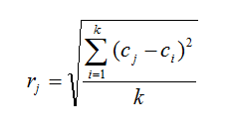
Unit width (r)
When the RBF centers have been established, the width of each RBF unit can be calculated using the K-nearest neighbors algorithm. A number K is chosen, and for each center, the K nearest centers is found. The root-mean squared distance between the current cluster center and its K nearest neighbors is calculated, and this is the value chosen for the unit width (r). So, if the current cluster center is c_{j}, the r value is:
A typical value for K is 2, in which case s is set to be the average distance from the two nearest neighboring cluster centers. Weights (w)
For each node in the hidden layer, now we have obtained the parameters r and c.
Now we compute the Euclidean distance from the point being evaluated to the center c of each neuron.
We then apply RBF(also called a kernel function) to the distance to compute the weight for each neuron.

Slide 10
CONCLUSION
So from this presentation, we have learnt that:
Practically RBF is better than the traditional networks as it is faster, simpler, has only one hidden layer and have wide range of applications.
The RBF network is a popular alternative to the well-known multilayer perceptron (MLP), since it has a simpler structure and a much faster training process and it is good for novelty detection as RBF neurons have maximum activation. RBF networks are a second paradigm of multi layer perceptrons.
Various aspects of the RBF network have been described, with emphasis placed on RBF network structure. Like we have seen that how three layers work and their properties and how the output is calculated.

